Slide 1

Team4 Nessus Network Scan
Team 3 : 100% Certified

Slide 2
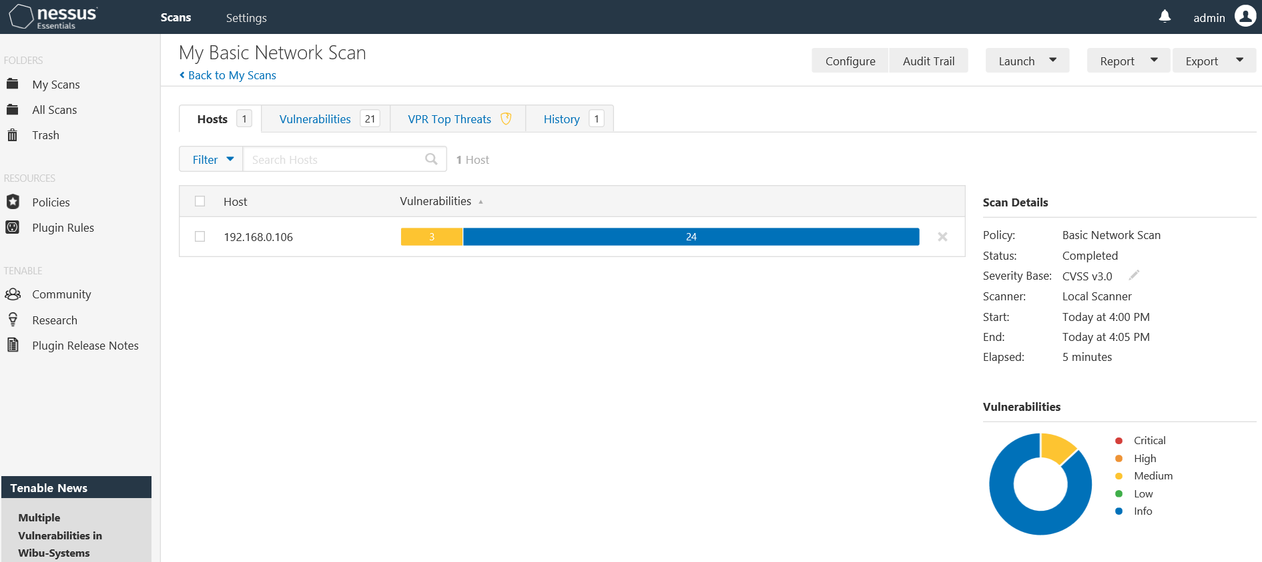

Slide 3
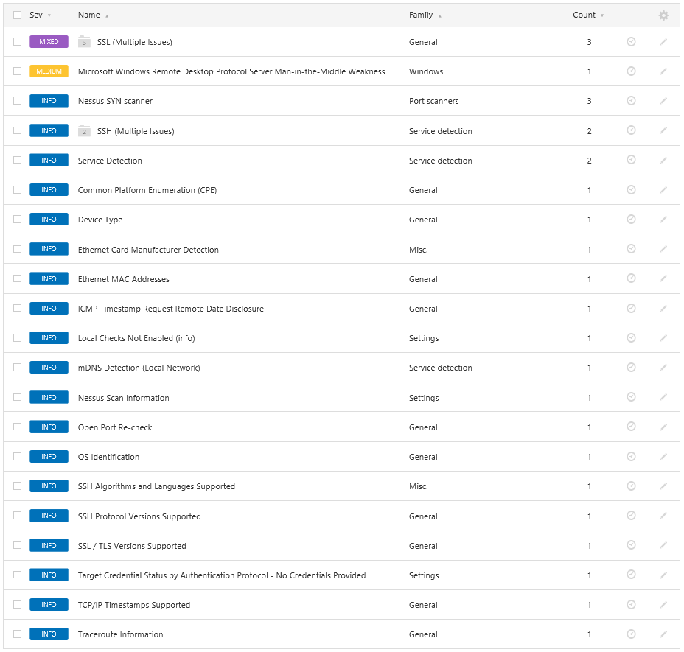

Slide 4
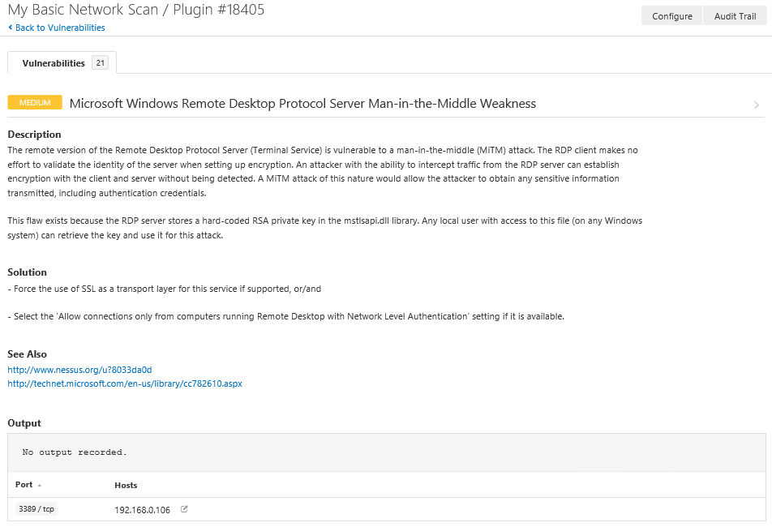

Slide 5
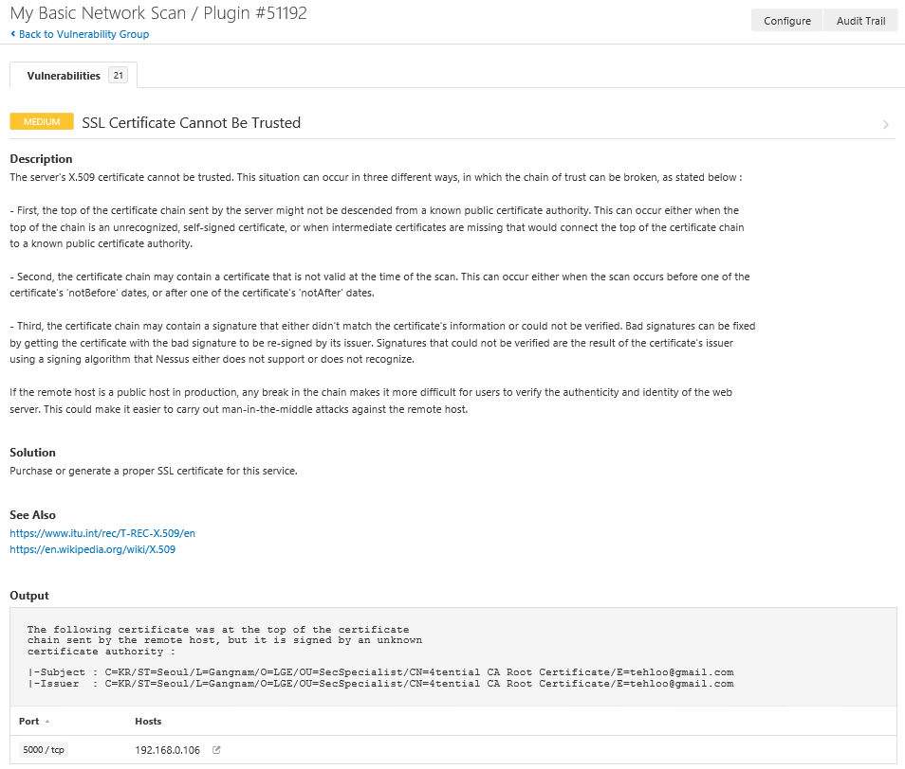

Slide 6
